Slide 1
Best use of Facebook by Gulf News
Gulf News submission for XMA Cross Media Awards 2012
Team: Anupa Kurian, Sanya Nayeem, Noor Al Khatib, Heather Madore, Mohammad Jihad, Huda Tabrez, Rabab Khan, Manuel Almario, Jumana Khamis and Sara Shurafa

Slide 2
Best use of Facebook by a newspaper
Gulf News Facebook page – “Gulf News Al Nisr Publishing UAE” – grows by an average of 1500 followers each month.
It promotes interactivity with readers through conversations, discussion boards, albums, comments, pictures, videos and links.
It generates unique reader content.
It sends traffic to the Gulf News website – 1 million (on an average) each month.
It pushes cross promotion of other products/content – Gulf News iPad Editions (twice daily – morning and evening).
It drives cross migration of content across platforms – print, website, social media channels and iPad.

Slide 3
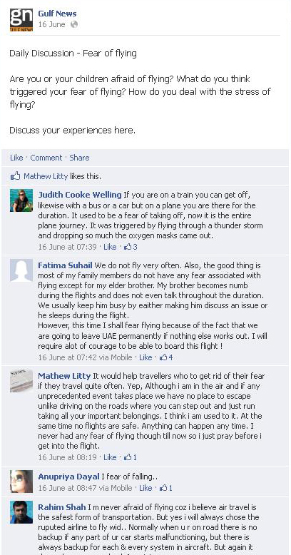
Promote interactivity with readers
We do several unique activities as part of the daily Facebook workflow. One of which is daily discussions, which are posted several times during the day to promote conversation.
Talking point stories are selected based on traffic on www.gulfnews.com
We push Twitter debate of the day.
We push Reader picture competition theme and submissions.
We create albums.

Slide 4
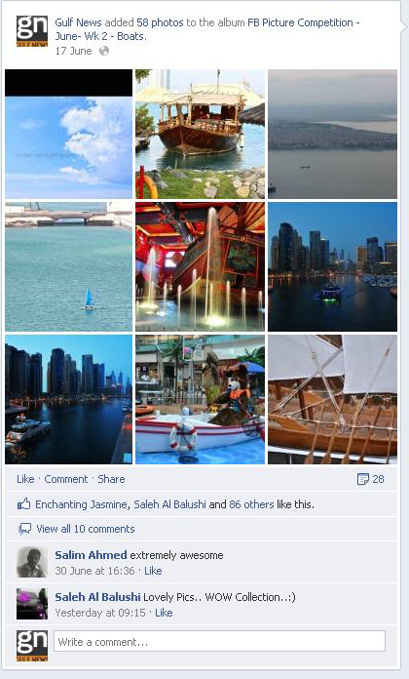
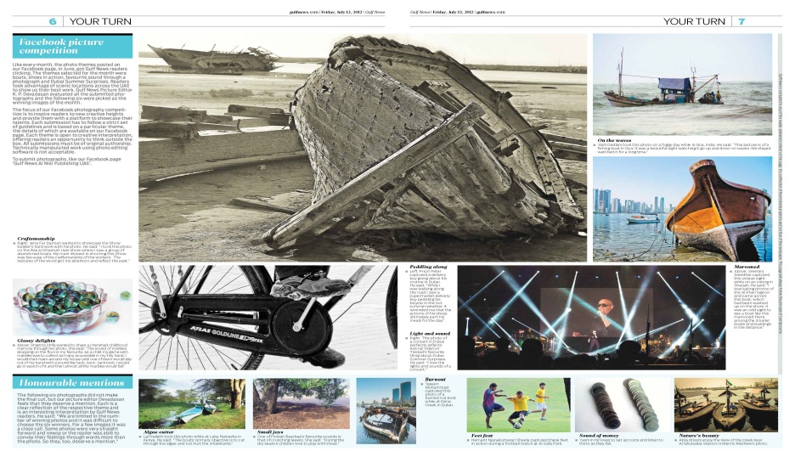
Generate unique content
Unique content is generated through the monthly photography Facebook competition.
This finds its place in the albums.
The best are then published – Photo Editor does the selection, with each winner getting an online gallery on the website (gulfnews.com)

Slide 5
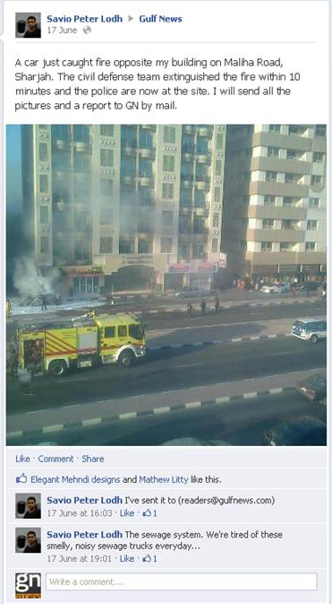
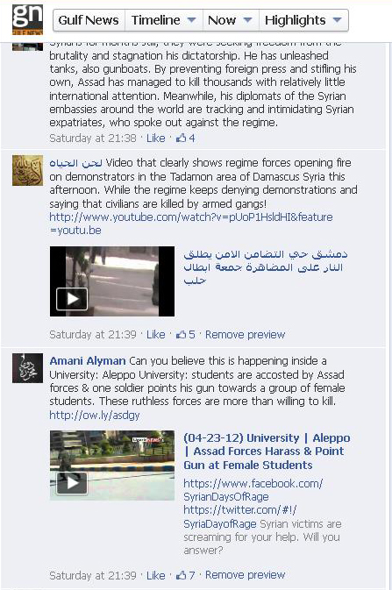
Generate unique content (contd)
Submissions for reader letters and comments, story tip-offs as well as videos and pictures get uploaded to our page.

Slide 6
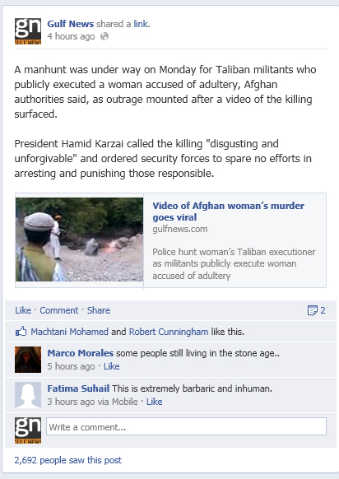
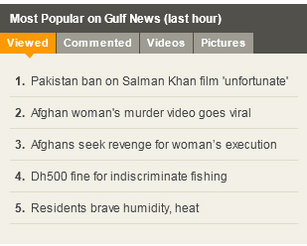
Send traffic to site
One of the top five stories from our website gulfnews.com is posted on our Facebook page every 30 minutes.

Slide 7
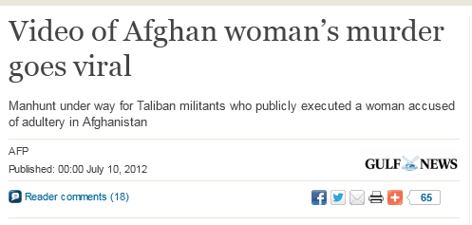
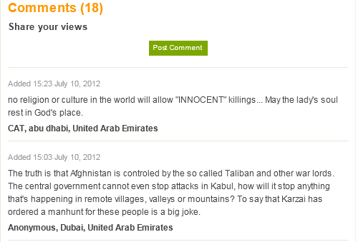
Send traffic to site (contd)
The stories on the website have an actively monitored post-comment process. This promotes interactivity for readers pushed across from the Facebook page.

Slide 8
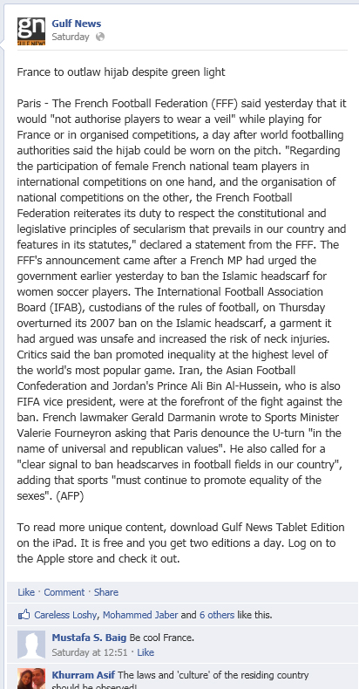
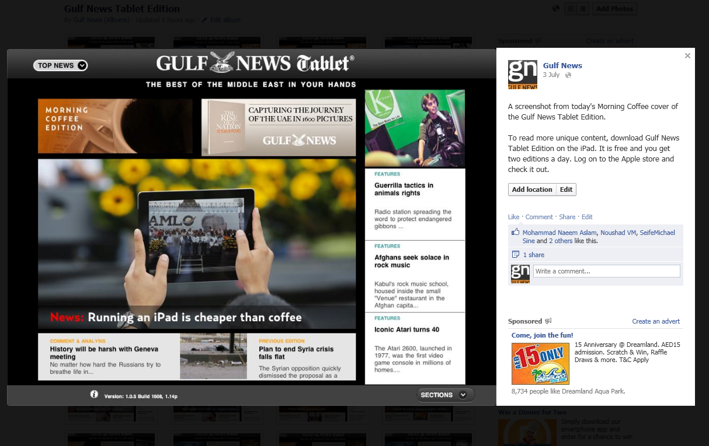
Cross promotion of other products/content
iPad stories and covers are promoted throughout the day. Covers are uploaded twice per day along with a unique story.

Slide 9
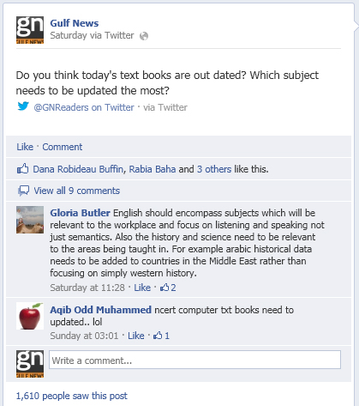
Cross promotion of other products/content
Twitter and Facebook accounts are linked allowing cross promotion of content.

Slide 10
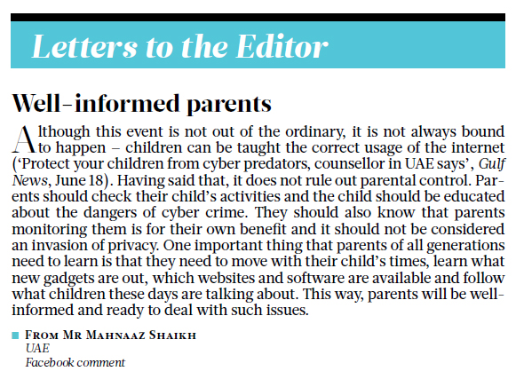
Cross migration of content
Content is pushed from the web onto Facebook. But, content is also pushed from online to print.

Slide 11
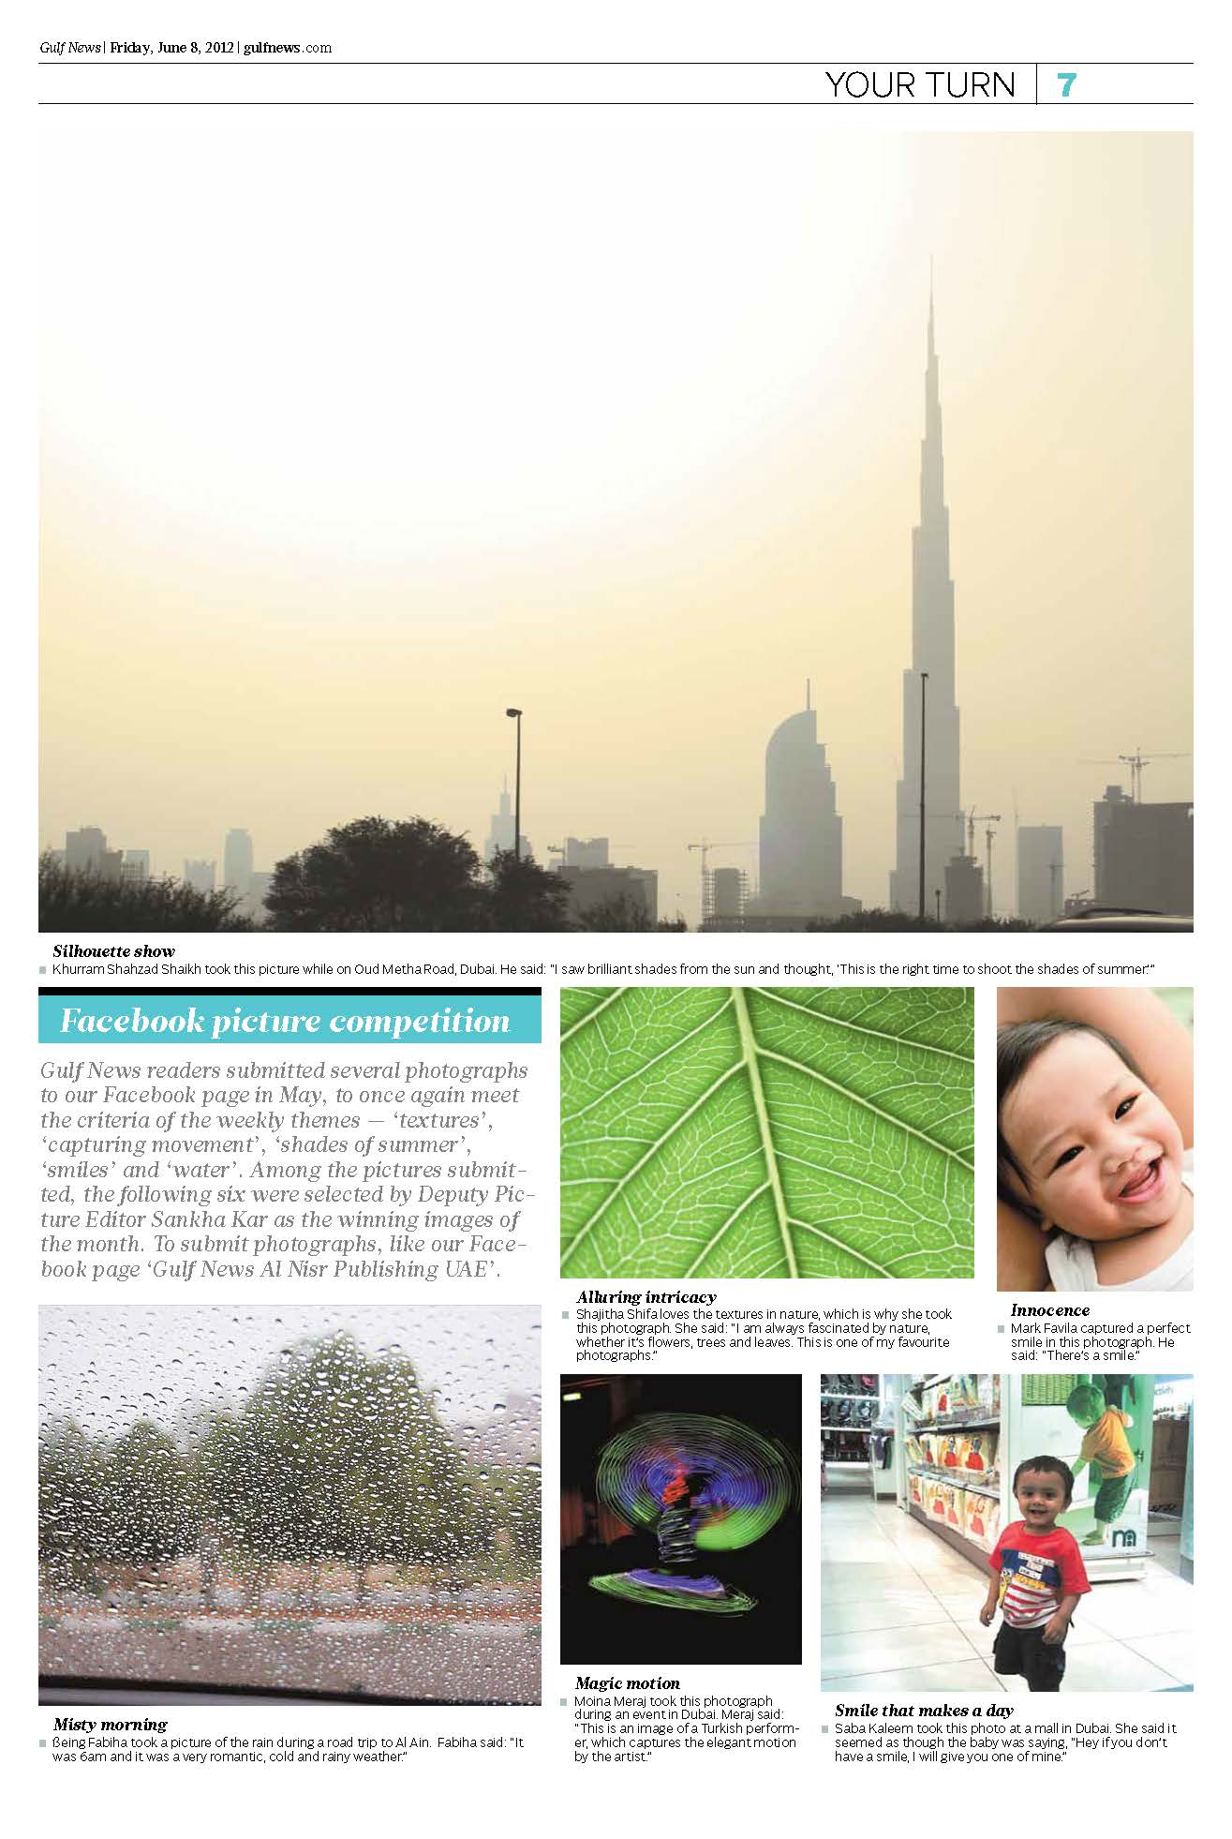
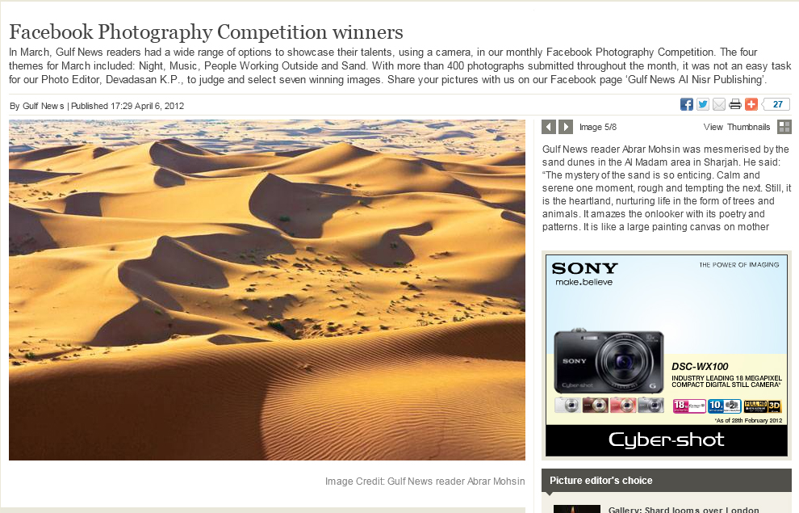
Cross migration of content (contd)
We select winners for the picture competitions and publish the winning photographs in print. These pictures are also promoted online in a web gallery.

Slide 12
Best use of Facebook by a newspaper
Gulf News is unique in the region for its use of Facebook as a channel to:
Create unique content
Generate online traffic
Promote community journalism
Drive reader interactivity
Push social debate
Thank you

